Slide 1
Welcome
CLIMATE-RESILIENT
INVESTMENTS

Slide 2
Rodrigo Navas
Director of the Manufacturing team at IDB Invest
Christian Parra
Investment Officer Climate Change at IDB Invest
Notes:
Good morning, my name is Malini Samtani and I work at IDB Invest . I am an officer at Advisory Services for the division of Climate Change.. XXXXX

Slide 3
Contents
IDB Invest Overview
The Climate Change Problem
The State of Green Buildings
The Business Case for Resiliency
Q&A

Slide 4
About Us
IDB Invest, a member of the Inter-American Development Bank (IDB) Group, is a multilateral development bank committed to the economic development of its member countries in Latin America and the Caribbean through the private sector. IDB Invest finances sustainable companies and projects so they can achieve financial results and maximize the region’s economic, social, and environmental development.
Governments
Civil Society
Corporates
Infrastructure
Financial Intermediaries
Innovation Ecosystem
Actors
Loans
Guarantees
Grants
Loans
Guarantees
Equity and Mezzanine Investments
Loans
Seed and Venture Capital Grants
Policy Advice
Technical Assistance
Knowledge
Knowledge Networks
Open Innovation
Advisory Services

Slide 5
At A Glance¹
AAA
Aa1
AA+
48
54%
60+
522
28
shareholders
employees
Fitch
ratings
of shares
years
offices
Moody’s
held by Latin America and the Caribbean
member countries
of experience in the region as
IDB Group
in Latin America, the Caribbean, Asia, and Europe
Standard
& Poor’s
¹Information as of March 2024

Slide 6
Our Value Added
Regional
knowledge
Public-private dialogue
Sector
expertise
We boost the development of our region with replicable, scalable financing and advisory solutions that help our clients face new challenges
Social & environmental value creation
Customized
financial solutions
Advisory
capabilities
Access to other funding sources

Slide 7
Priority Sectors
Infrastructure
Energy
Transport
Water and
Sanitation
Social
Infrastructure
Corporates
Agribusiness
Manufacturing
Tourism
Digital Economy
Financial
Intermediaries
Investment Funds
Financial Institutions
Non Banking Financial Institutions

Slide 8
Financial products
Financial solutions
Financial services
Loans
Guarantees
Equity and Mezzanine
Investments
Trade and Supply
Chain Finance
Capital Market Instruments
& Structured Finance
Blended Finance
Resource
Mobilization
Advisory services
Gender, Diversity and Inclusion
Technology and Innovation
Climate
Change
MSMEs and Sustainability
Public-Private Partnerships (PPP)
Environmental & Social Risk Management
Corporate
Governance

Slide 9
IDB Invest offers a single value proposition by linking
financial and non-financial products
Advisory Services helps foster sustainable and inclusive impact on IDB Invest operations
BETTER PROJECTS
Support clients by improving existing transactions
Identify sustainable solutions to grow clients’ business
+
+
ADVICE
KNOWLEDGE
INVESTMENT
BETTER MARKETS
Help surface new investment opportunities
Create a positive influence in our markets

Slide 10
Our Most Recent Market Awards
2021
Multilateral Development Bank of the Year

Slide 11
A.
The Climate Change Problem
Notes:
Agenda: voluntario

Slide 12
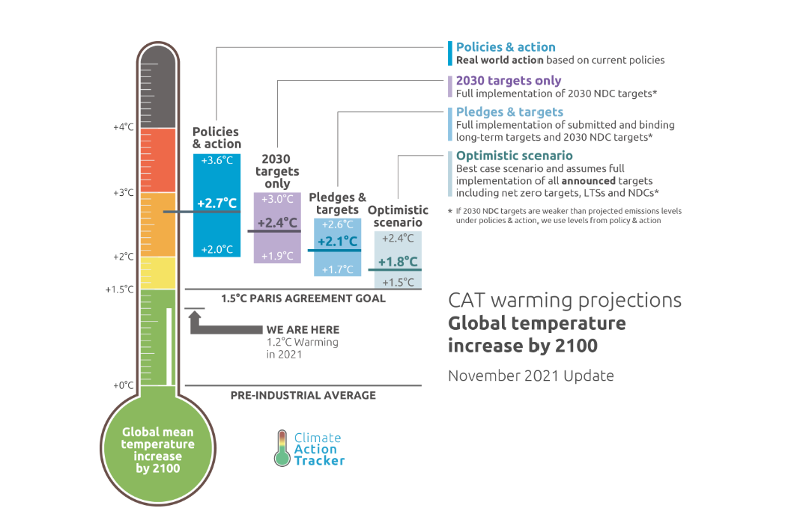
190+ Countries committed to limiting temperature
rise to 1.5 degrees

Slide 13
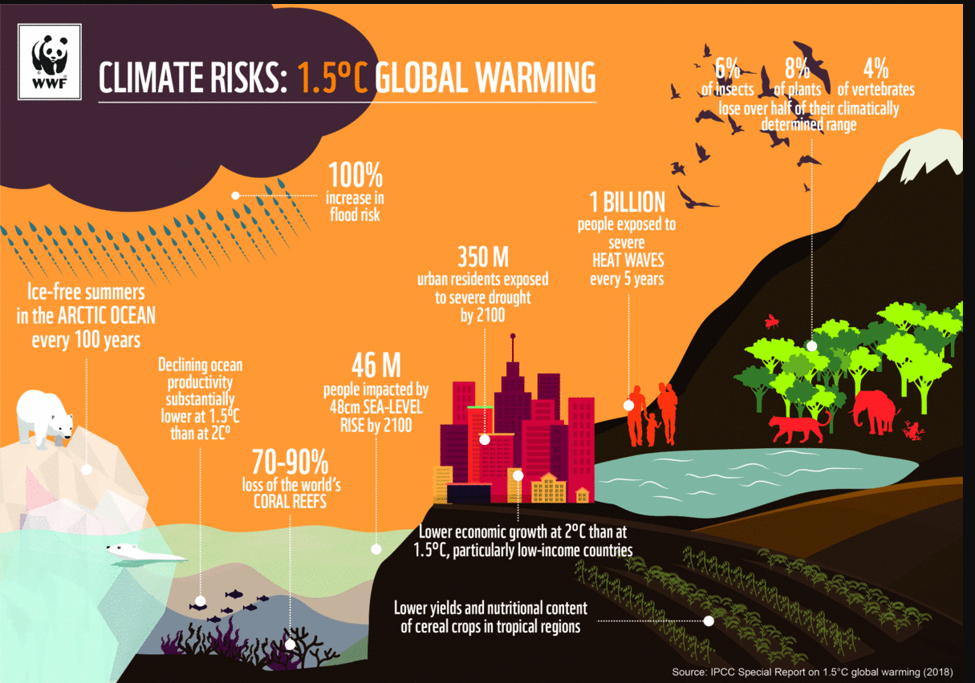
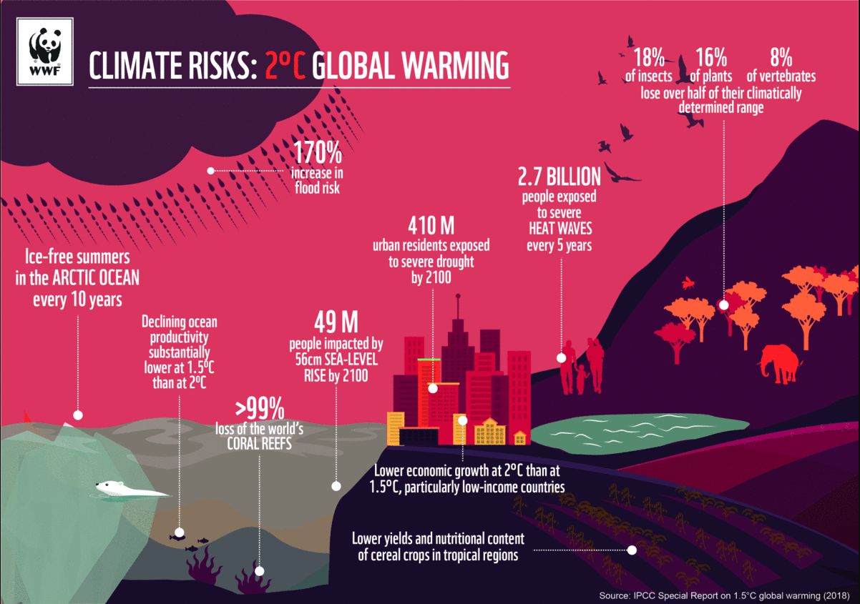
Climate Change Impacts: 1.5 degrees vs. 2 degrees

Slide 14
A two-pronged approach to Climate Action: Mitigation and Adaptation
Reduce GHG Emissions (Mitigation)
Increase Resilience (Adaptation)
Positive list
Projects and operations that reduce the emissions that contribute to climate change
Examples: Solar power, sustainable transportation, energy efficiency
Actions that manage and reduce the negative impacts of climate change.
Location and context specific
Examples include infrastructure upgrades, flood protection, and business continuity planning
Notes:
Context of vulnerability: The operation clearly sets out the context of climate change vulnerability using a robust evidence base, and adaptation activities that are required to strengthen the recipient’s policy and institutional framework. b. Intent: The operation supports the recipient to identify policy actions that can contribute to adaptation and sets out the explicit intention to develop such policy actions consistent with the context of vulnerability and in line with relevant adaptation strategies and plans. c. Clear and direct link between climate change vulnerability context and policy actions: The policy actions included in the MDB operation directly contribute to addressing the identified climate change vulnerabilities and/or enabling adaptation.

Slide 15
B.
Resiliency Solutions
Notes:
Agenda: voluntario

Slide 16
INTERVENTIONS TO INCREASE CLIMATE-RESILIENT INVESTMENTS IN BARBADOS, JAMAICA & TRINIDAD & TOBAGO
Identification of Hazards and
Resilience Measures
16

Slide 17
INTERVENTIONS TO INCREASE CLIMATE-RESILIENT INVESTMENTS IN BARBADOS, JAMAICA & TRINIDAD & TOBAGO
Caribbean Islands face climate risks due to their size and location. Droughts, hurricanes, floods, warmer temperatures, and sea level rise threaten the environment and the economic sectors of the region
WHY
This Photo by Unknown Author is licensed under CC BY-SA
Notes:
But why did we spend XXX in this Study.. Well, Caribbean Islands are particularly vulnerable to climate-relate risks due to their size and location. Droughts, hurricanes,Floods, warmer temperatures, and sea level rise are some of the intensifying dangers that threaten the environment and economic sectors of the region. Therefore, climate adaptation in the form of climate-resilient infrastructure is crucial to endure the effects of climate change. Considering the increasing severity of climate-related events and the lack of resiliency measures in construction to date, capacity building is essential. There is a market for incorporating climate resilience into new or preexisting infrastructure - with the greatest willingness to pay for heat resilience measures. We developed this publication to reduce the market inefficiencies identified. It highlights the main drivers and potential returns on investment associated with incorporating adaptive and resilient design and construction practices in buildings in three Caribbean countries. The project will focus on the residential and commercial sectors in Jamaica, Trinidad and Tobago and Barbados.

Slide 18
Individuals, SMEs, and residential and commercial development projects will need to prepare for the increased frequency and intensity of climate events in Jamaica
5% increase in peak hurricane wind speeds and increased frequency of intense hurricanes
Increasing trends in one-day and five-day extreme rainfall likely to lead to more severe floods
7% reduction in precipitation resulting in
at least one severe drought per decade.
Regional sea level rise is estimated at a current rate (2006 to 2015) of 2.5mm/year.
Temperatures have already risen by 1 degree Celsius, with projections
of another .8 degrees increase and recent decades showing accelerated warming.
Hurricane wind annualized losses have average US$215 million, while annualized losses from flooding are $20 million in Jamaica. Energy consumption from increased cooling costs was estimated to cost US$, 8.7, million per year for Jamaica
Notes:
Context of vulnerability: The operation clearly sets out the context of climate change vulnerability using a robust evidence base, and adaptation activities that are required to strengthen the recipient’s policy and institutional framework. b. Intent: The operation supports the recipient to identify policy actions that can contribute to adaptation and sets out the explicit intention to develop such policy actions consistent with the context of vulnerability and in line with relevant adaptation strategies and plans. c. Clear and direct link between climate change vulnerability context and policy actions: The policy actions included in the MDB operation directly contribute to addressing the identified climate change vulnerabilities and/or enabling adaptation.

Slide 19
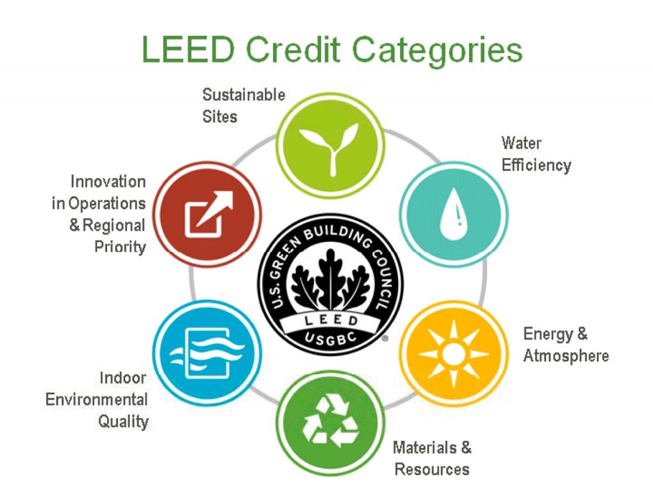
Sustainability Certifications in buildings: Focused reduction of carbon emissions (Climate Change Mitigation)
Incorporating sustainability into construction is a competitive advantage. Sustainability certifications incorporate efficient infrastructure and appliances that
save money, reduce carbon emissions and the negative impact on the environment
19

Slide 20
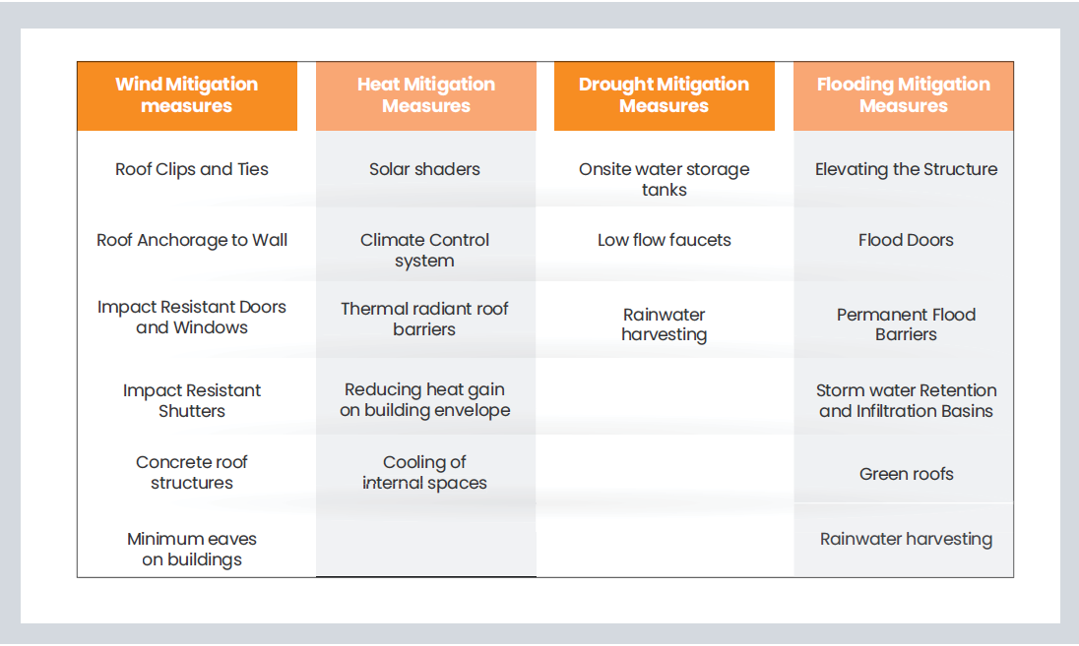
SOLUTIONS
Resilience Measures
20

Slide 21
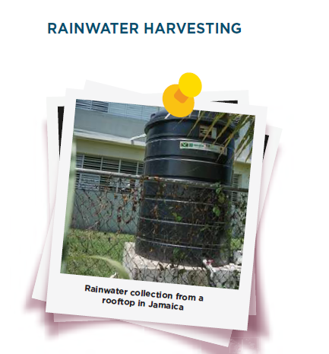
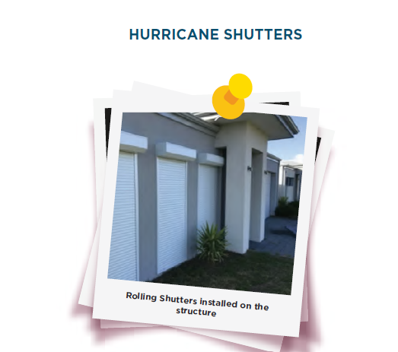
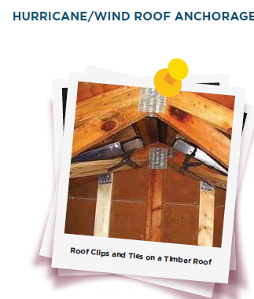
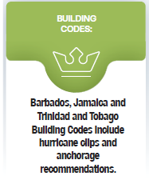
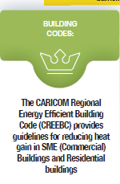
Solutions: Resilience Measures

Slide 22
Small and Medium Enterprise (SME) & Residential Landscapes
Due to extreme climate-related events, business continuity impact varies across the SME landscape based on years in business and vulnerability
Market sizing: Jamaica has 711,331 dwelling units. Current demands outstrip market supply with deficits of unmet annual demands of 15,000 for Jamaica per year
Architypes1 were proposed for residential and commercial buildings to enable cost comparison of resilience measures. They consist of 70m2 affordable-income housing solutions SME buildings are 465m2.
The 5-year potential for residential property development market in Jamaica is estimated US$14.8 billion, respectively; while for commercial property, the market is US$2.2 billion.
22

Slide 23
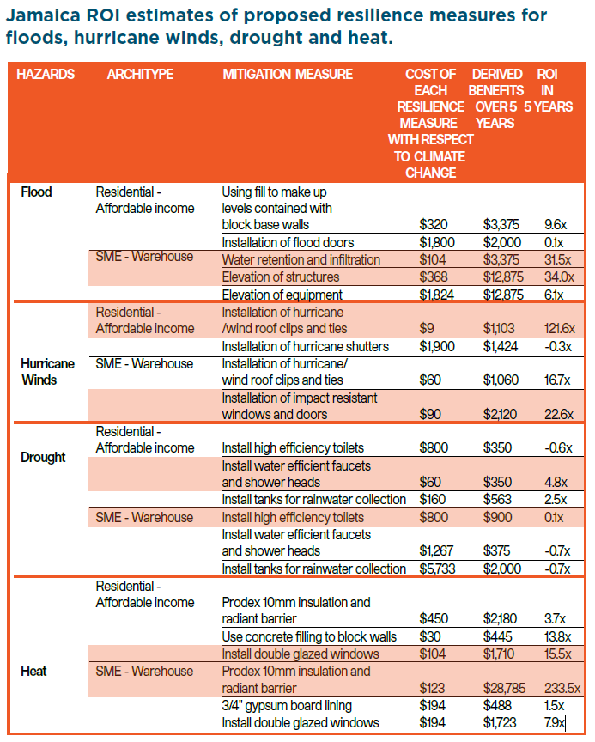
OPPORTUNITIES
The Business Case
Savings Estimates
*Paying a 1-2% premium
for property resiliency measures can offer financial benefits
up to 30-fold over 5 years
23

Slide 24
OPPORTUNITIES
The Business Case
Planning, Design & Construction
Services
Architects, technical consultants, contractors, developers
Consultants, digital mapping and other services to develop plans for resilient business solutions
“There is a massive business opportunity for SMEs to sell or offer these climate change resiliency products and services”.
Operation Maintenance Renovation
Financing
Product sales
Private investors, banks, buyers
Equipment
Individuals, private business, facilities service providers
*Roof clips and ties for wind, and solar shades for heat
24

Slide 25
OPPORTUNITIES AND NEXT STEPS
For the Market
Educate consumers on the importance of climate-resilient infrastructure to reduce risks and potential losses.
INTERVENTIONS TO INCREASE CLIMATE-RESILIENT INVESTMENTS IN BARBADOS, JAMAICA & TRINIDAD & TOBAGO
There is a willingness to include resilience add-ons products in mortgage financing for new buildings or retrofitting existing infrastructure.
Capacity building is required to allow the construction industry to experiment with prototypes that meet
purchasers’ safety needs as well as encourage
developers to incorporate these measures in the construction
25

Slide 26
THANK YOU
Let’s continue the conversation
www.idbinvest.org
www.idbinvest.org/linkedin
www.idbinvest.org/twitter
www.idbinvest.org/facebook
Blog - www.idbinvest.org/blog
Notes:
‘Thank you

Slide 27
E.
ANNEX
Notes:
Agenda: voluntario

